Slide 1
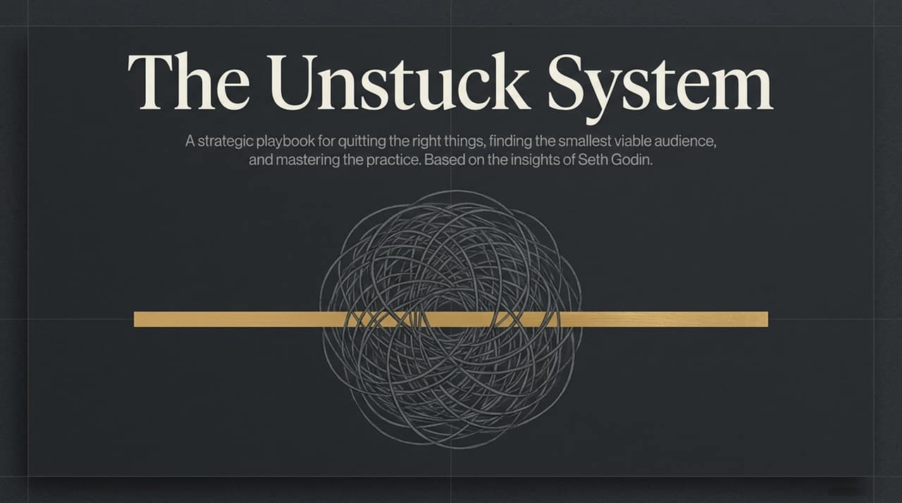
Notes:
Welcome everyone. I want to start with a very common feeling, one that often holds us back more than any external obstacle. It’s the feeling of being stuck. You want to make a career pivot, but you don't. You have a great idea for a podcast, but you never hit record. You want your organization to innovate, but it stays paralyzed.
The assumption we often make is that getting stuck is a lack of willpower, or perhaps a lack of talent. Today, I want to argue—based on the lifetime of work by Seth Godin—that being stuck is not a personnel problem; it’s a systems problem.
This session is not about generic motivation. It’s a strategic playbook. We are going to deconstruct the mechanics of paralysis. We will learn how to distinguish between obstacles that guarantee breakthrough (the Dip) and those that guarantee failure (the Cul-de-sac). We will learn how to find the single "central pole" of fear or desire anchoring your immobility. And finally, we will learn how to build "the practice" that allows you to start, even when you feel like an imposter.
This is the strategic playbook for moving forward. Let’s look at the oldest stuck system in human history.
https://www.youtube.com/watch?v=g7AxxkywiFI

Slide 2
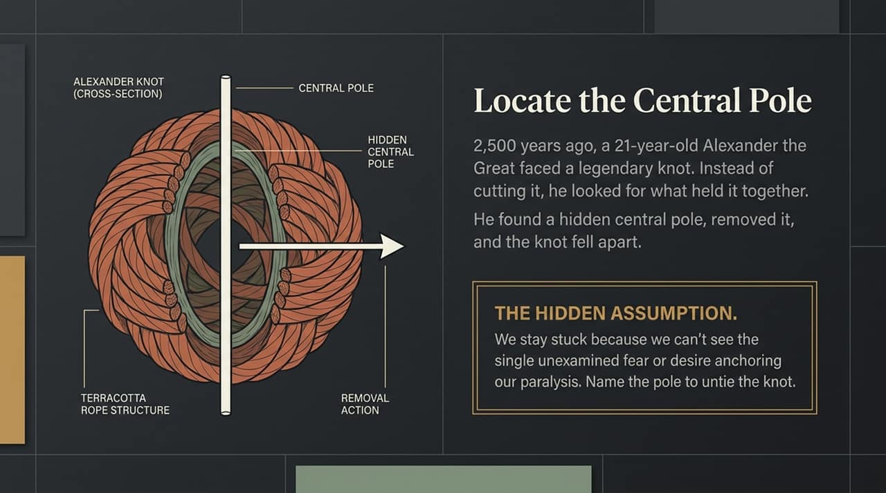
Notes:
This diagram illustrates a cross-section of the legendary Gordian Knot, or as labeled here, the Alexander Knot.
The legend, nearly 2,500 years old, tells of a knot so complex it was thought impossible to untie. A prophecy said that whoever could undo it would rule all of Asia. Many tried and failed, using traditional force.
Then a 21-year-old Alexander the Great arrived. He didn't try to pull on the frayed ends. Instead, he studied the system. In our illustration, we see he located the "Central Pole"—the invisible core holding the entire structure together. Instead of cutting the knot (as one version of the legend says), we see him here executing a simple "Removal Action." He removed the one object anchoring the paralysis. And the entire, terrifying knot fell apart.
This isn't just a history lesson. This is a model for your psychological paralysis.
Seth Godin argues that we often stay stuck because we are obsessed with the complex, frayed ends of our problem—the external factors. But every complex struggle has a hidden central pole. This is the Hidden Assumption: the single, unexamined fear or conflicting desire that anchors your immobility. If you name that central pole, you can untie the knot.
Let's look at the most common central pole anchoring modern professional life.

Slide 3
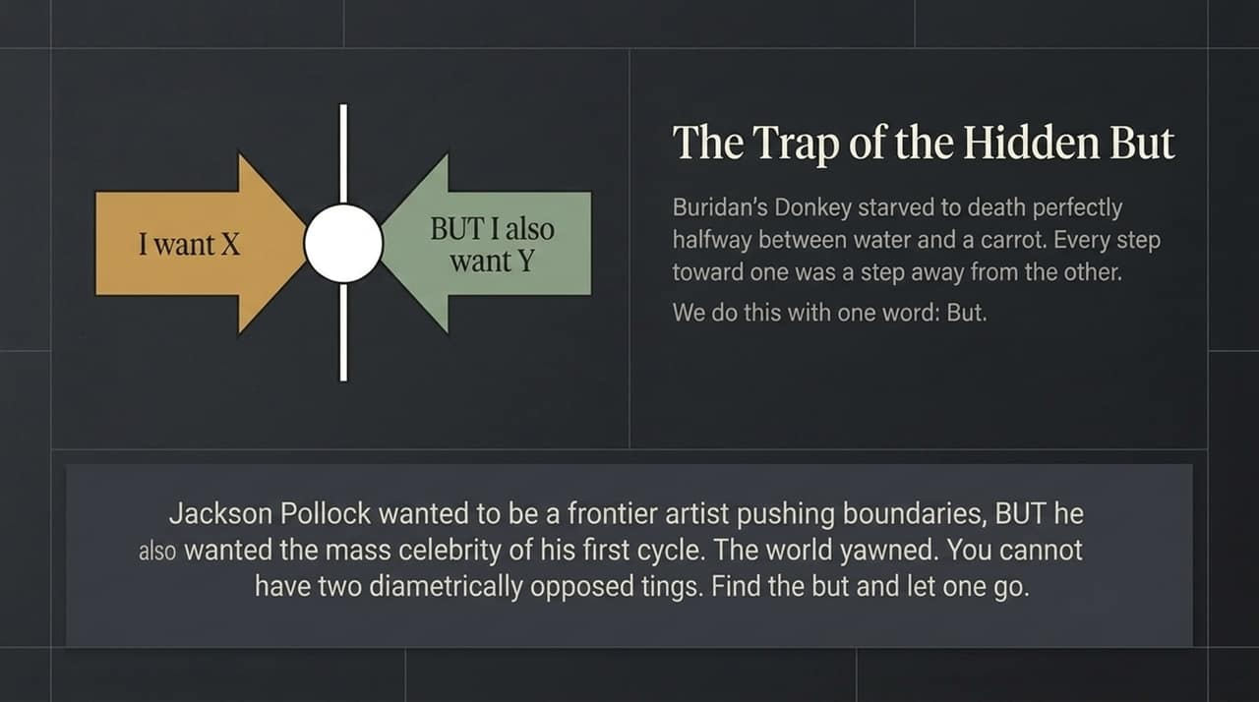
Notes:
This diagram perfectly illustrates what Seth calls the "Donkey Dilemma," based on the philosophical fable of Buridan's Donkey.
Imagine a donkey perfectly halfway between a bucket of water and a bucket of carrots. It is hungry, and it is thirsty. But every step toward the carrots was a step away from the water, and vice versa. Unable to resolve the conflict, it stood paralyzed and starved to death halfway in between.
We do this using a single, devastating word: BUT.
You want to pivot your business and be a "frontier artist," breaking new ground (X), BUT you also want the "mass celebrity" and guaranteed validation of your old work (Y). In this image, we highlight Jackson Pollock. He wanted boundary-pushing creativity, but he wanted immediate fame. When you try to have two diametrically opposed things at the same time, the world—just like the donkey’s internal compass—simply yawns. Paralysis wins.
Godin’s advice is simple and brutal: Locate the hidden central pole. Name the two opposing things, accept you cannot have both simultaneously, and strategically let one go. In Pollock’s case, he could have the creativity, but only if he risked the immediate fame. Once he chose, he became unstuck.
Now let’s look at the next reason we stay stuck: the Sunk Cost Receipt.

Slide 4
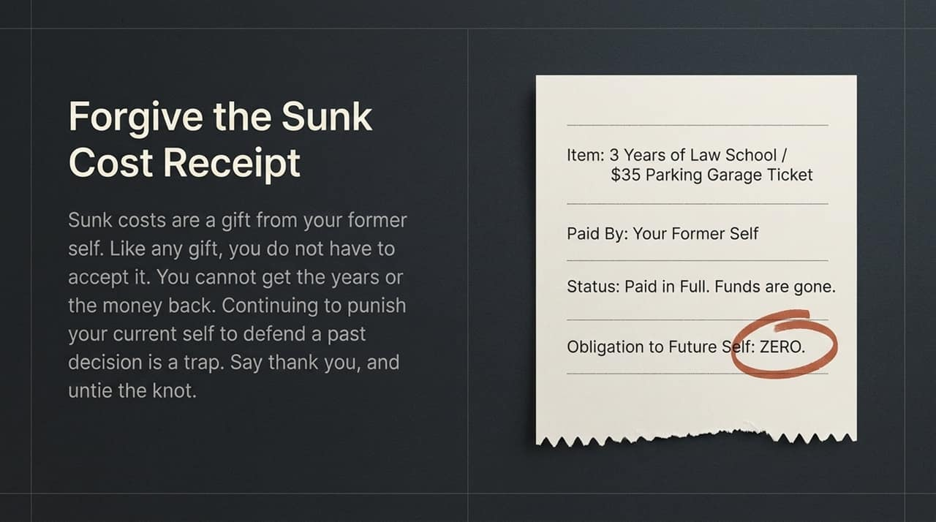
Notes:
We continue defending decisions made by our former self, not because they are currently right, but because we already spent resources on them.
This conceptual slide shows us a physical Sunk Cost Receipt. Item: Three years of law school. Status: Paid in Full. Funds are gone.
We stay stuck in careers we hate, or bad investments, because we feel obligated by what we have already paid. Seth provides a crucial mindset shift here: Sunk costs are a gift from your former self. Like any gift, you do not have to accept it.
Look closely at the obligation to your future self listed on this conceptual receipt: it is ZERO.
Continuing to punish your current self by defending a past decision is not loyalty; it’s a trap. Say thank you for the gift, throw away the receipt, and untie the knot of obligation so you can move forward.
This leads us to the next psychological anchor. Once we decide to move, we encounter resistance. Let's deconstruct it.

Slide 5
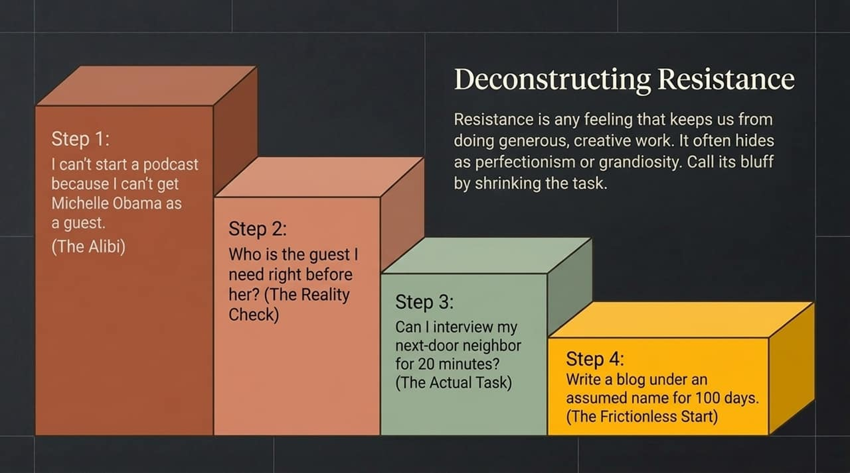
Notes:
Resistance is a crucial concept. It is ANY feeling that keeps you from doing generous, creative work. It usually hides behind noble-sounding alibis.
Resistance often manifests as two related behaviors:
Perfectionism: A fear that the work won't be good enough (or that we aren't good enough).
Grandiosity: An irrational alibi that we cannot begin until we have impossible resources.
In this image, we visualize the alibi of grandiosity. "I can't start a podcast because I can't get Michelle Obama as a guest." This sounds noble! You are aiming for excellence! But Seth argues this is just Resistance talking. It's a convenient excuse to not begin.
The way you beat Resistance is by shrinking the task. We move to the reality check. Ask yourself: "Who is the guest I need right before Michelle Obama?" When you trace that chain backward, you get to Step 3, the Actual Task: "Can I interview my next-door neighbor for 20 minutes?"
Suddenly, the grandiosity evaporates. The real task is manageable. Call Resistance’s bluff by shrinking the goal until it’s Frictionless to begin.
Shrinking the task allows you to handle the fear of starting. But how do you handle the fear that comes once you are underway?

Slide 6
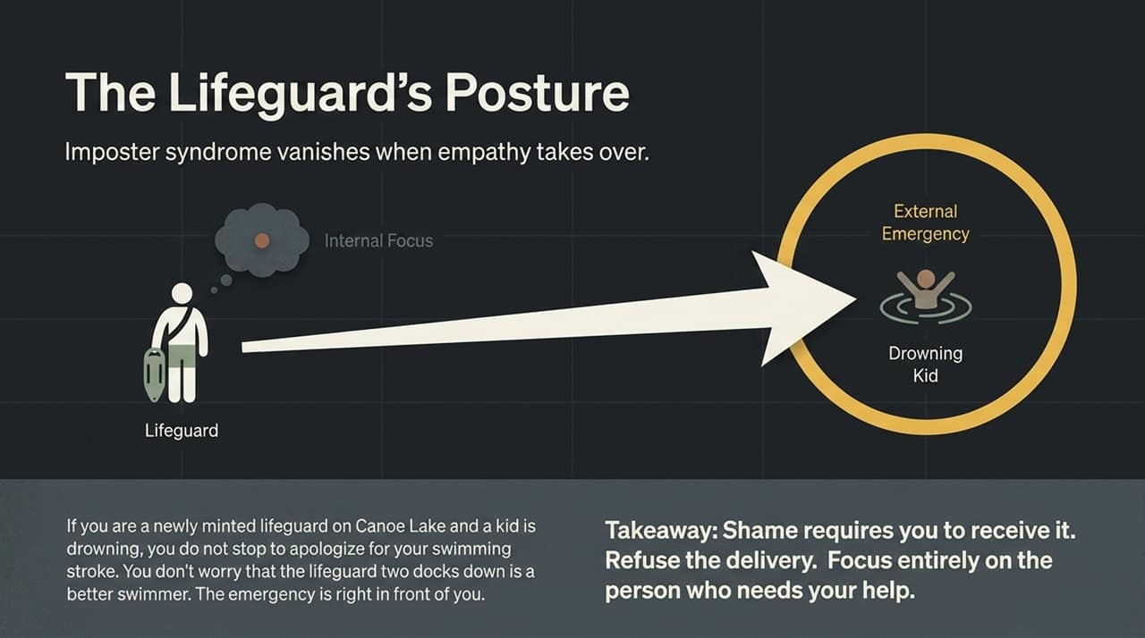
Notes:
This conceptual diagram illustrates why Imposter Syndrome—the feeling that we are faking it—is so common and how to solve it.
Look at the Internal Focus box. This is the mode of shame and self-doubt. It requires you to receive it. You are wondering, "Am I a fraud? Do people think I'm qualified? Is my work as good as that other person's?"
Now, contrast this with the External Emergency box.
Imagine you are a newly minted lifeguard on Canoe Lake. A child starts drowning. In that instant, do you pause to apologize for your swimming stroke? Do you worry that the lifeguard two docks down is a better swimmer? No. The entire structure of your self-regard vanishes because the emergency is right in front of you.
Seth Godin argues that Imposter Syndrome vanishes when empathy takes over. Refuse to receive the delivery of shame. Focus entirely on the person who needs your help, the drowning child, or the specific user problem you are trying to solve. If you serve them, you are not an imposter; you are a professional.
This shift to empathy is what allows you to start the practice.

Slide 7
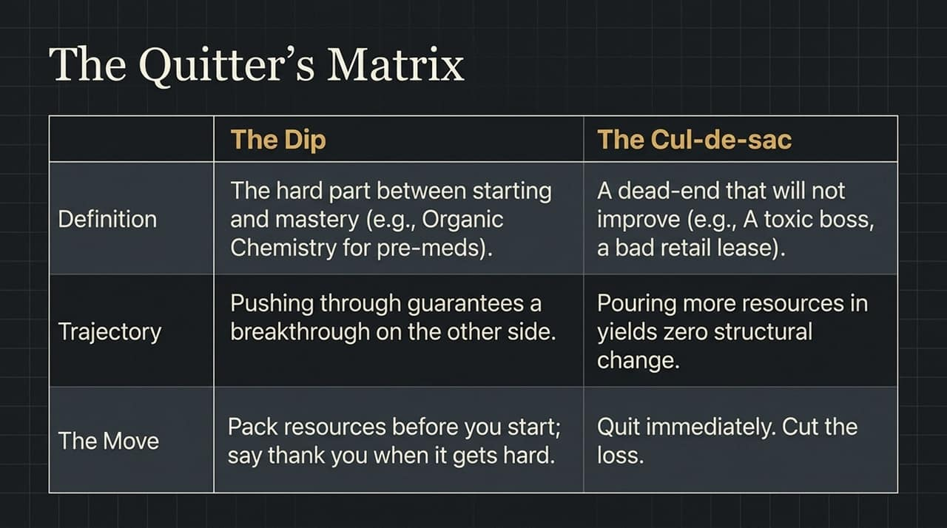
Notes:
This brings us to one of Seth Godin's most powerful strategic ideas: Mastering "The Practice."
He uses the metaphor of learning to juggle. Amateurs fail at juggling because they lunge to catch the ball. By focusing on the Output (the catch), they lose their position, their center, and they drop everything.
Professionals understand The Juggler's Secret. Juggling is not about catching. It is about throwing.
This conceptual image diagramming juggling breaks down your work into two components:
INPUT (The Throw): This is The Practice. It is showing up, writing the words, recording the podcast, making the calls. This is 100% within your control.
OUTPUT (The Catch): The results. Metrics, money, status, viral hits. This is 0% within your control.
The strategic move to get unstuck is to build a daily practice where you detach from the catch and master the throw. If you spend 20 minutes a day doing nothing but making perfect throws, the catches will take care of themselves.
Focus exclusively on the throw.

Slide 8
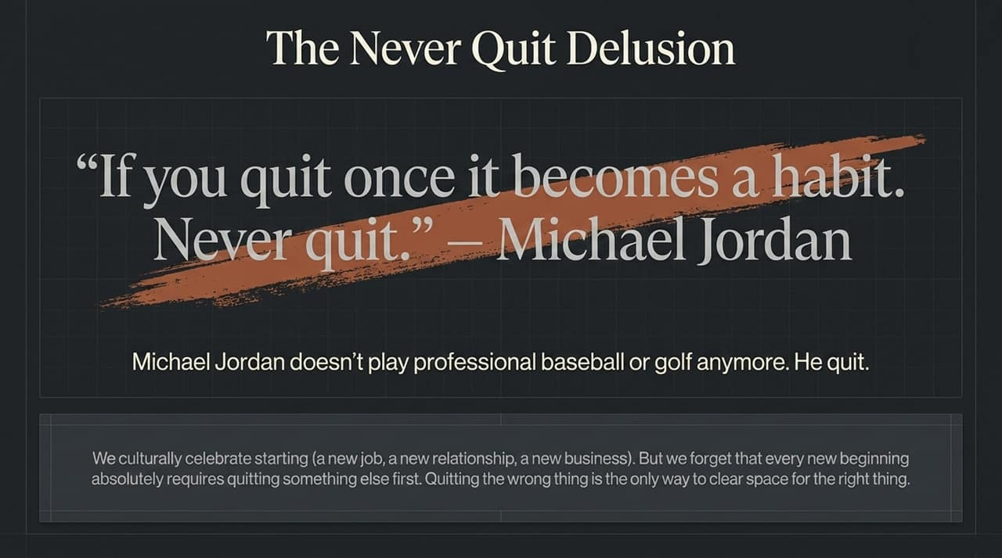
Notes:
A core reason we get stuck is that we mistake one type of obstacle for another. We either quit too early on the right things or stay too long on the wrong ones.
Seth gives us The Quitter's Matrix to strategically solve this. We must learn to distinguish between two systems: The Dip and The Cul-de-sac.
The Dip: Look at the visual here. The Dip is the long, arduous grind between starting and mastery. It’s Organic Chemistry for pre-meds. It is intentionally difficult because pushing through guarantees a breakthrough. In the Dip, the scarcity of mastery is what creates the value. When it gets hard, you don’t lunge to escape. You say thank you, lean into the practice, and master the throw.
The Cul-de-sac: Now look at the alternate visual path. A dead-end that will not improve, regardless of how much effort you put in. A toxic boss, a bad retail lease in a dying neighborhood. In a cul-de-sac, pouring in more resources yields zero structural change. Your effort is meaningless because the system itself is designed to stall.
The strategic moves are opposites: Break through the Dip; quit the cul-de-sac immediately. Cut your losses. This matrix lets you free up the energy needed to make strategic moves.
Let's address the massive delusion that prevents us from quitting dead ends.

Slide 9
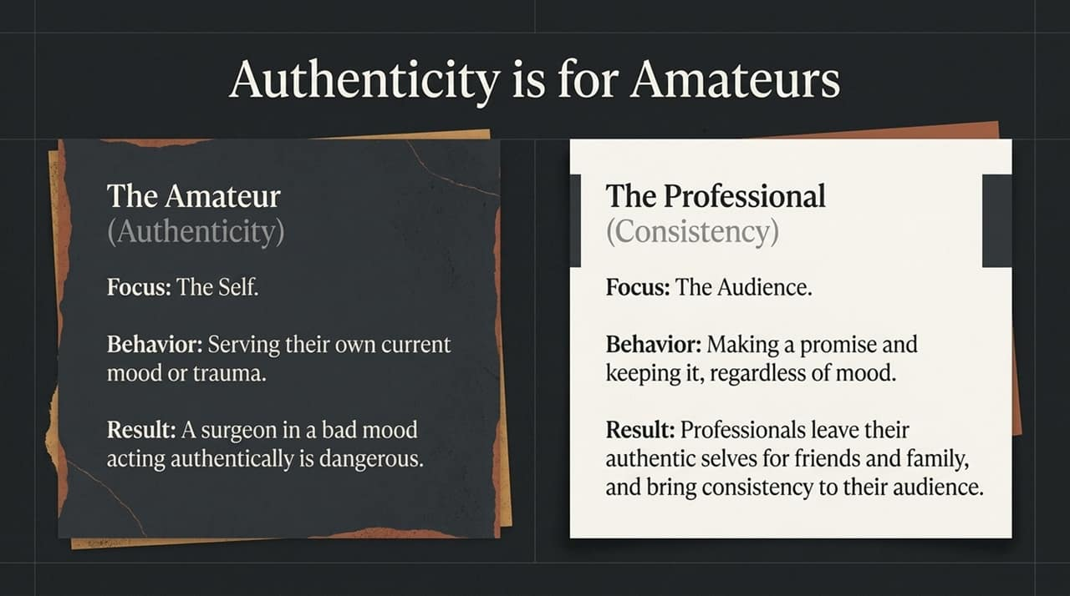
Notes:
We are culturally indoctrinated with the idea that quitting is failure. We hear quotes like this one, conceptualized here, attributed to Michael Jordan: "If you quit once it becomes a habit. Never quit."
This sounds inspiring, but it’s a delusion. As Seth Godin points out, Michael Jordan doesn't play professional baseball or golf anymore. He quit. He is a professional quitter.
Our culture celebrates starting. A new job, a new relationship, a new business. We love that energy. But this conceptual image illustrates a crucial truth we forget: Every single new beginning absolutely requires quitting something else first.
If your hands are full holding onto the cul-de-sac, you cannot lunge to grasp the new opportunity. Quitting the wrong thing is the only way to strategically clear space for the right thing.
By mastering the Quitter's Matrix and clearing space, you can finally serve your chosen audience. But what kind of work do they need?

Slide 10
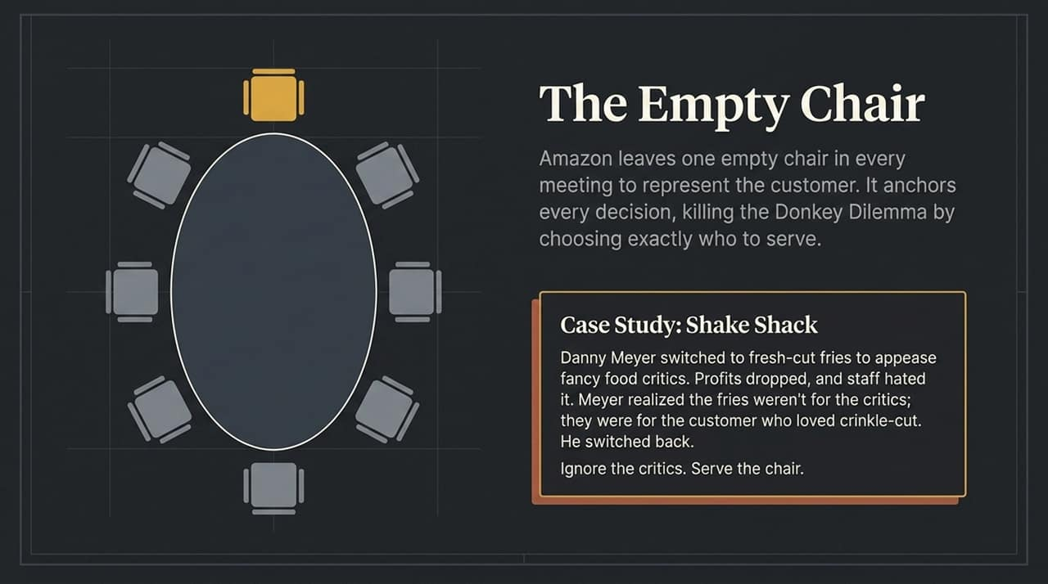
Notes:
This conceptual slide breaks down a common buzzword that actually keeps creators stuck. Authenticity.
In this matrix, Seth distinguishes the amateur from the professional. We stay stuck because we are obsessed with our own authenticity.
Look at The Amateur. Authenticity is their anchor. Their focus is on the Self. Their behavior is serving their own mood or current trauma.
Consider this illustration’s outcome: If a surgeon is having a bad day, do you want them to be an authentic surgeon? Absolutely not. That surgeon would be dangerous.
The goal is not authenticity; the goal is The Professional. Consistency is their anchor. The focus is not on the self, but on the Audience. A professional makes a promise and keeps it, regardless of mood.
If you serve your next-door neighbor on your frictionless start podcast, you leave your messy, authentic self for your friends and family. You bring consistency to your audience. This consistency is what builds trust and allows you to find your others.
Once you have consistency, you can use the most powerful strategic tool in business: The Empty Chair.

Slide 11
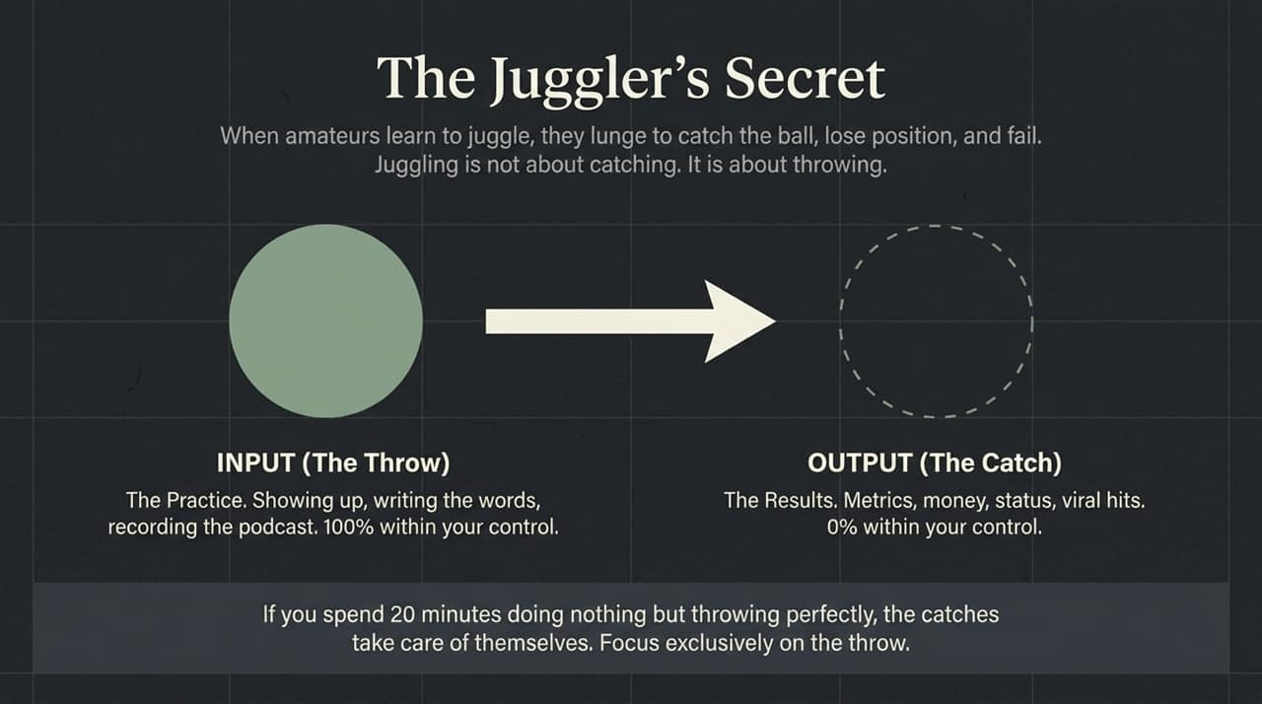
Notes:
This powerful visual illustrates a practice Amazon uses to make decisions. They leave one empty chair in every meeting.
What does that chair represent? It represents the Customer. The user. The specific person you are trying to help.
Remember the Buridan's Donkey dilemma? The donkey starved because it didn't know who to serve first.
Serving the empty chair is the ultimate Donkey Dilemma killer. When you have a decision to make, don't ask what you want, or what is easiest. Strategically choose exactly who you will serve. Name the chair. Serve it above all else.
Let's look at a classic case study from Shake Shack. Danny Meyer, the founder, wanted a better-rated burger, so he strategically switched to fancy, fresh-cut fries to appease the critics. But profits dropped, and staff hated it. He realized the critics were not in the chair. The empty chair belonged to the customer who loved crinkle-cut. The moment he strategically switched back to the "worse" but right product, Shake Shack became a multi-billion-dollar brand.
Ignore the critics. Master consistency, detach from the output, and serve the chair.

Slide 12
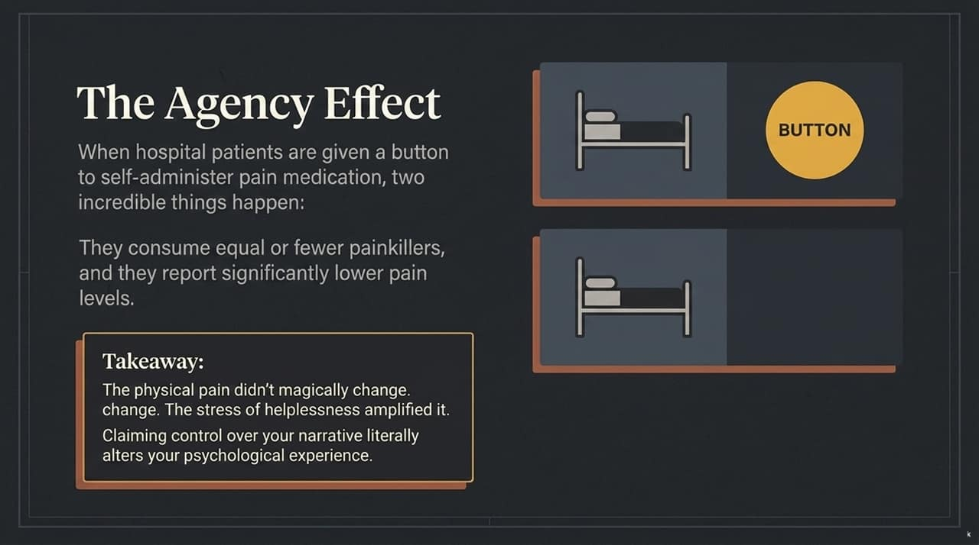
Notes:
This image illustrates a fascinating psychological truth that helps us handle the process of being stuck or unstuck.
When hospital patients are given a button that allows them to self-administer pain medication, two incredible things happen:
They consume equal or fewer painkillers overall.
They report significantly lower pain levels.
The takeaway from Seth Godin is this: The physical pain in their system didn't magically change. It was the stress of helplessness that was amplifying their perception of pain.
Paralysis feels awful. Being stuck in the cul-de-sac or struggling in the Dip feels like a crisis. But when you claim control of your own narrative—when you can strategically decide when to quit or how to make perfect throws—that sense of agency literally alters your psychological experience. It makes the work less painful.
This is the strategic framework. Let's synthesize the whole system.

Slide 13
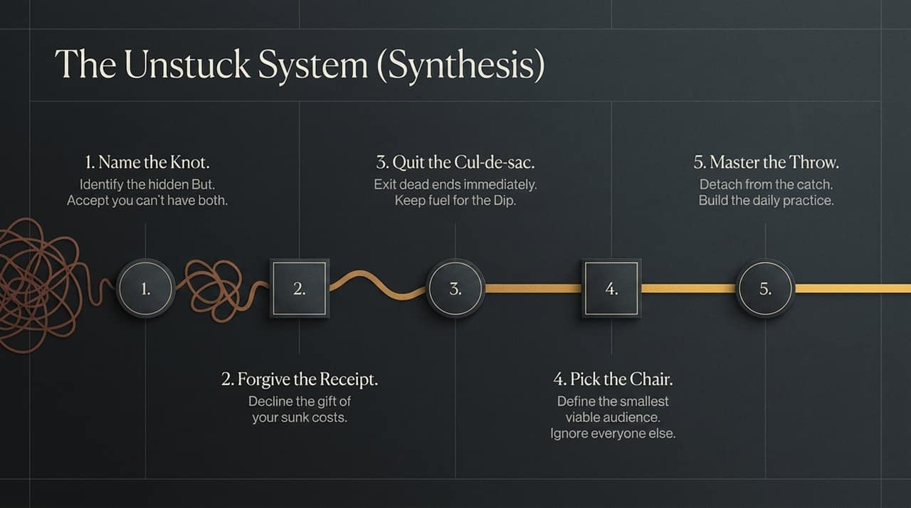
Notes:
This is the conceptual progress path we have just navigated. This is the Unstuck System. Let's synthesize it into a strategic checklist.
Name the Knot. Locate the Hidden Assumption anchoring your paralyzing Donkey Dilemma. Identify the conflicting desire, the "BUT." strategize, make a decision, and accept you cannot have both.
Forgive the Receipt. Throw away the sunk costs obligating your past self.
Quit the Cul-de-sac. Exit dead ends immediately so you can free up the fuel needed to navigate the Dip and master consistency.
Pick the Chair. Define the smallest viable audience you will serve. Ignore everyone else.
Master the Throw. Build a daily, frictionless practice based on consistency, not mood. Detach from the catch (metrics and results) and focus exclusively on the throw.
This system is within your control. You don't need anyone's permission to apply it. Let's close with the example of a woman who proved that.

Slide 14
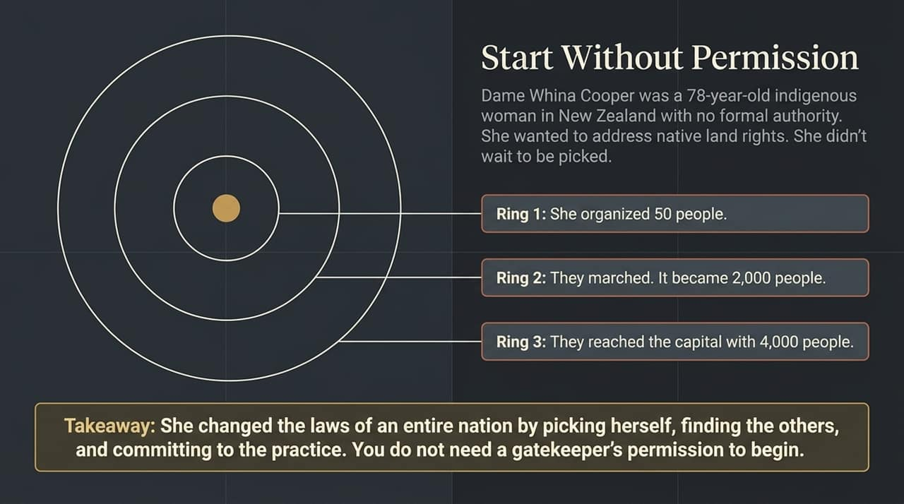
Notes:
This conceptual graphic illustrates the path of Dame Whina Cooper, a 78-year-old indigenous woman in New Zealand.
Cooper had no formal authority. She had no corporate structure or official gatekeeper permission. But she wanted to address indigenous land rights.
This illustration shows us the rings of impact. Seth Godin uses this as the ultimate model for picking yourself. Cooper didn't wait to be picked.
She organized 50 other people—her smallest viable audience.
They committed to the practice. They began.
They marched. The consistency was impossible to ignore. They found their others. Fifty became a march of 2,000 people.
They reached the capital with 4,000 people. Dame Cooper changed the actual land laws of an entire nation.
This is the power of picking yourself. Find the others. Commit to the practice. Start without permission.
Which brings us to our final metric.

Slide 15
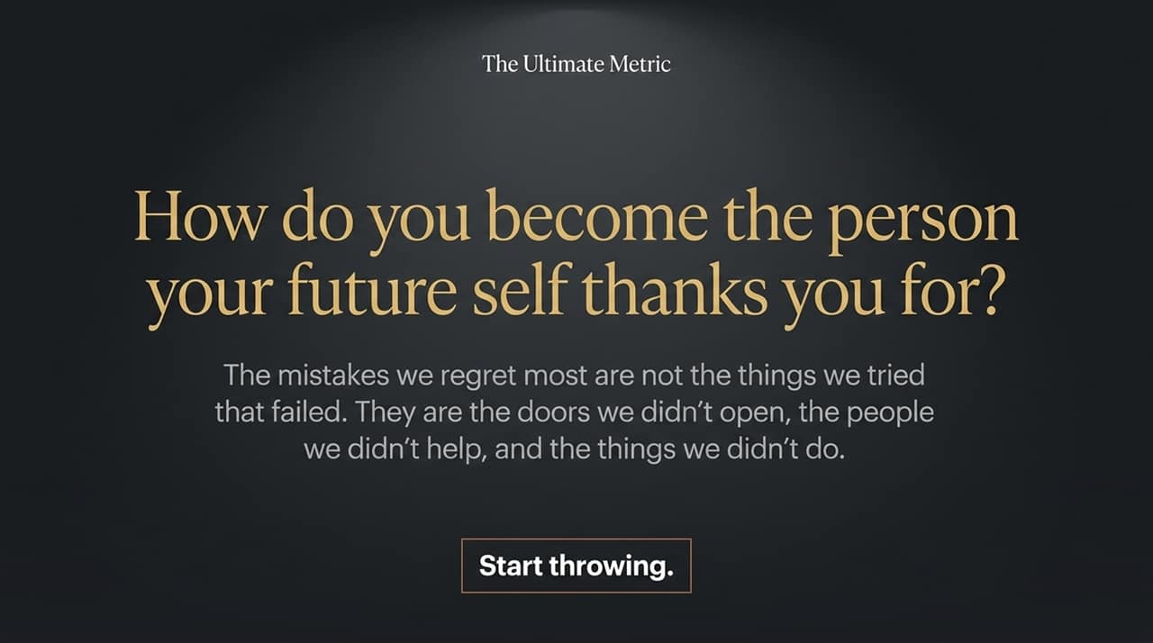
Notes:
We end with a powerful conceptual question. How do you strategically measure if you are winning?
It is easy to focus on the wrong output, the short-term catching. The real metric, Seth argues, is a long-term strategic investment question: How do you become the person your future self thanks you for?
When you survey people about their biggest regrets, they rarely list the things they tried that failed. Their biggest strategic regrets are always the doors they did not open, the people they did not help, and the things they did not do.
Regret is the ultimate stuck cost.

Slide 16
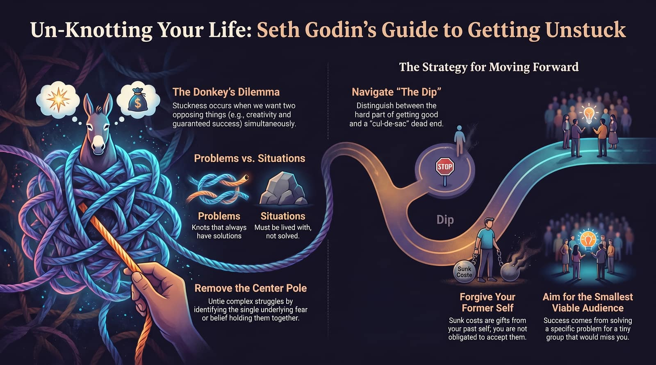
Notes:
You now have the strategic playbook. You understand the hidden but. You know how to distinguish the Cul-de-sac from the Dip. You understand the danger of mood-based authenticity and the imposter syndrome trap.
You have agency. Start throwing.
The most important thing you can do now is not to memorize this strategy, but to apply the system. Go find your friction-less start. Find your neighbor. Pick your chair. Don't lunge for the catch.
Build the practice. Thank you.

